Slide 1
Math and Portuguese Grade Analysis
Rui Tang

Slide 2
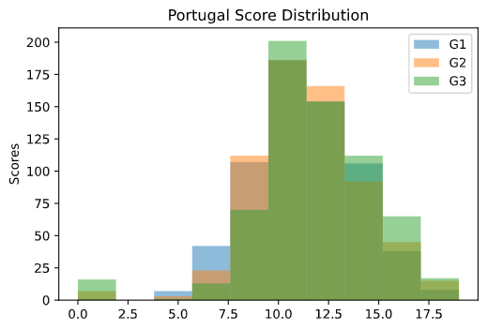
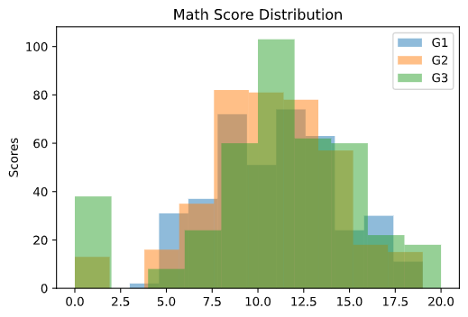
Score Distribution
We can see in both distribution charts, 3 types of distribution are very similar. By calculation we can see correlation coefficient are larger than 80 percent.
That means students who get higher scores in G1 and G2 can also get higher scores in G3.

Slide 3
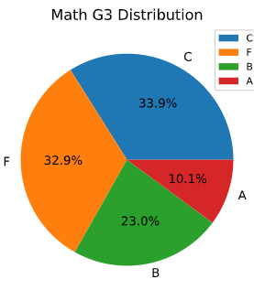
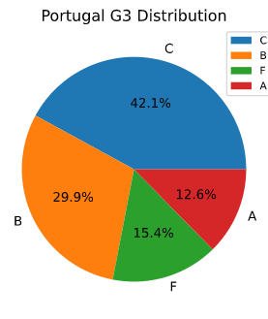
Score Portions
100 - 80% -> A
79 – 65 -> B
64 – 50 -> C
50 – 0 ->F
Seems like math is easier than Portuguese

Slide 4
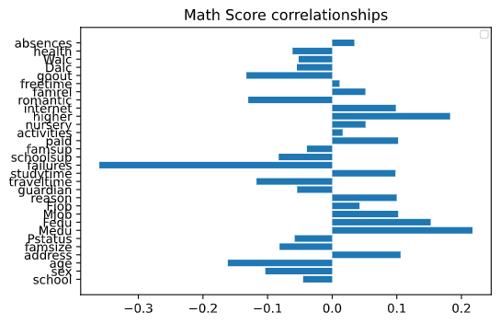
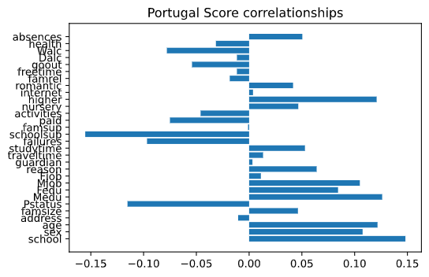
Correlations

Slide 5
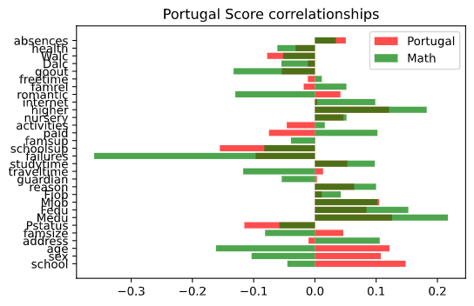

Slide 6
Most features make sense but …
Absences can improve grade a little, why?
A romantic family is good for Portuguese, but not good for math.
Higher parent education level are dramatically good for both subjects
Males perform better in math, while females do better in Portuguese
Failures are vary harmful, of course…
Fathers are more dominant in tutoring mathematics, compared with Portuguese

